Slide 1

KICKBOTS
PRESENTED BY OHMIES
GROUP - 12
ITM

Slide 2
Team Members
245031B - P.D.V.D.Gunasekara
245056F - K.Lathursan
245124M - S.M.M.A.B. Madugalla
245057J - B.L.N.N.Liyanage
245060L - S.M.K.Madhushani

Slide 3

OUTLINE
1. Introduction
2. Aims and Objectives
3. Problem & Solution
4. Block Diagram
5. Other Diagram
6. 3D View
7. Implementation
8. Components
9.Individual Contribution

Slide 4

Introduction
KickBots Arena is an innovative 2-player robotic football system .
Each player controls a striker robot and its kicker for attacking and a goalkeeper robot for defense. A Web application acts as the main control and display system.

Slide 5
Aim & Objectives
Aim
To design and develop a 2-player robotic football arena where each player controls a striker and goalkeeper robot using wireless communication and an interactive web interface, enabling a real-time, competitive and automated gaming experience.
Objectives
Build striker and goalkeeper robots with precise movement
Implement wireless control using joysticks and nRF24L01 modules
Create a web-based interface to display timer, match status, and live score updates
Detect goals automatically using IR sensor modules
Control goalkeeper movement on a linear rail system using DC motors and limit switches
Ensure all microcontrollers (Arduino, ESP32) communicate reliably in real-time
Develop a reset and match-restart functionality with scoring history
Enable a smooth multiplayer experience with minimal delay

Slide 6
Problem &Solutions
Problem
Traditional tabletop and arcade football games lack realistic control, automation, and accurate scoring. Player actions like shooting or goalkeeping are limited, and scoring is manual and error-prone. Most robotic games are single-player, offering no real-time competition or engaging, automated gameplay.
Solution and features
KickBots Arena is a 2-player robotic football game with full automation and wireless control.
Each player controls two robots: a striker (with a kicker) and a goalkeeper (on a rail).
IR sensors detect goals, and scores update instantly on a web app.
The web interface handles match time, controls, and winner display.
Wireless modules ensure smooth and responsive gameplay.

Slide 7
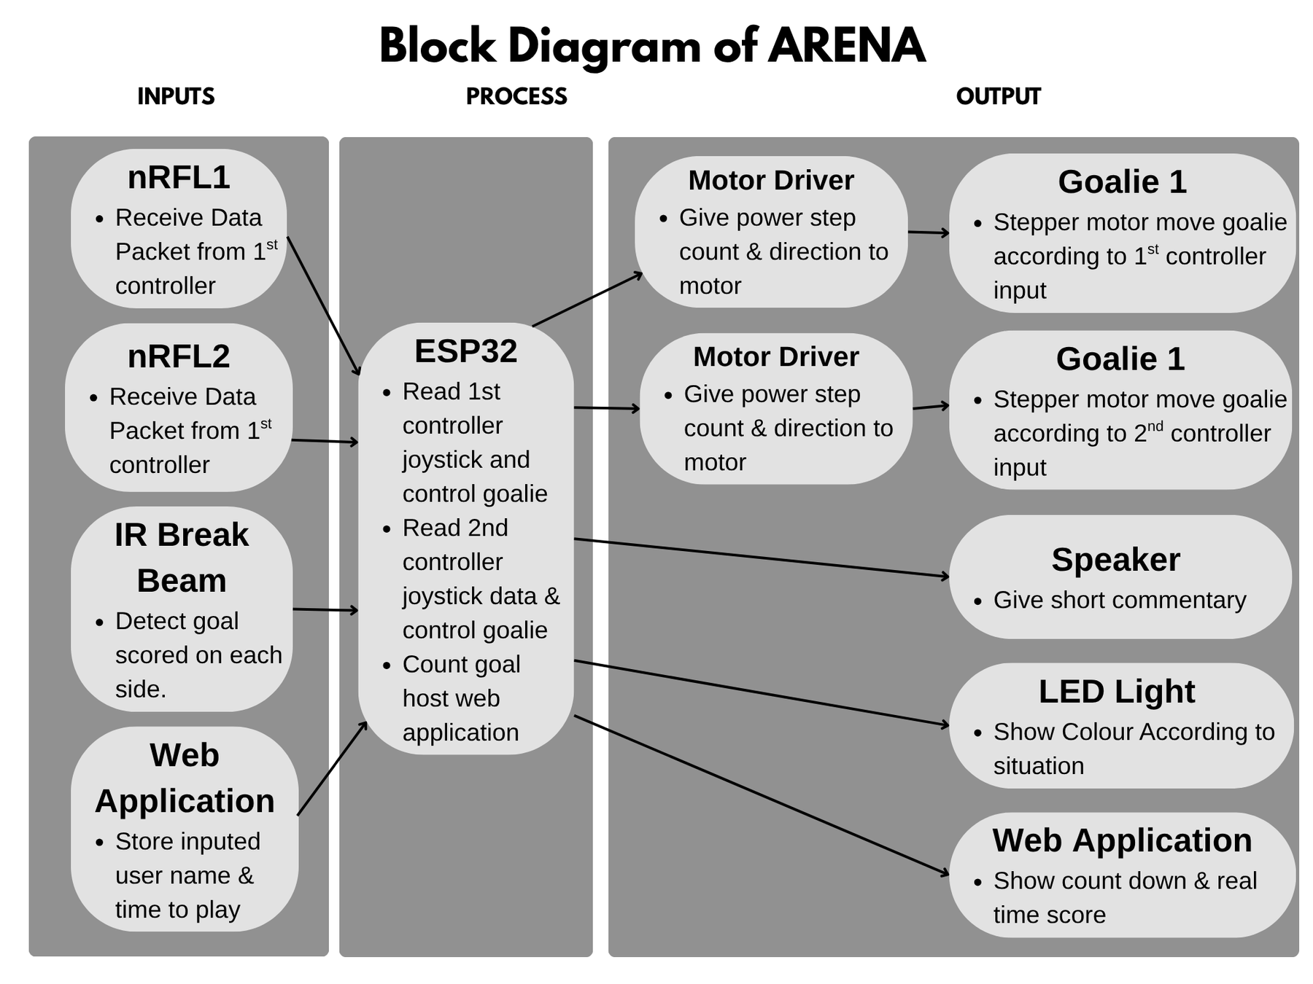
Block diagram
01. ARENA

Slide 8
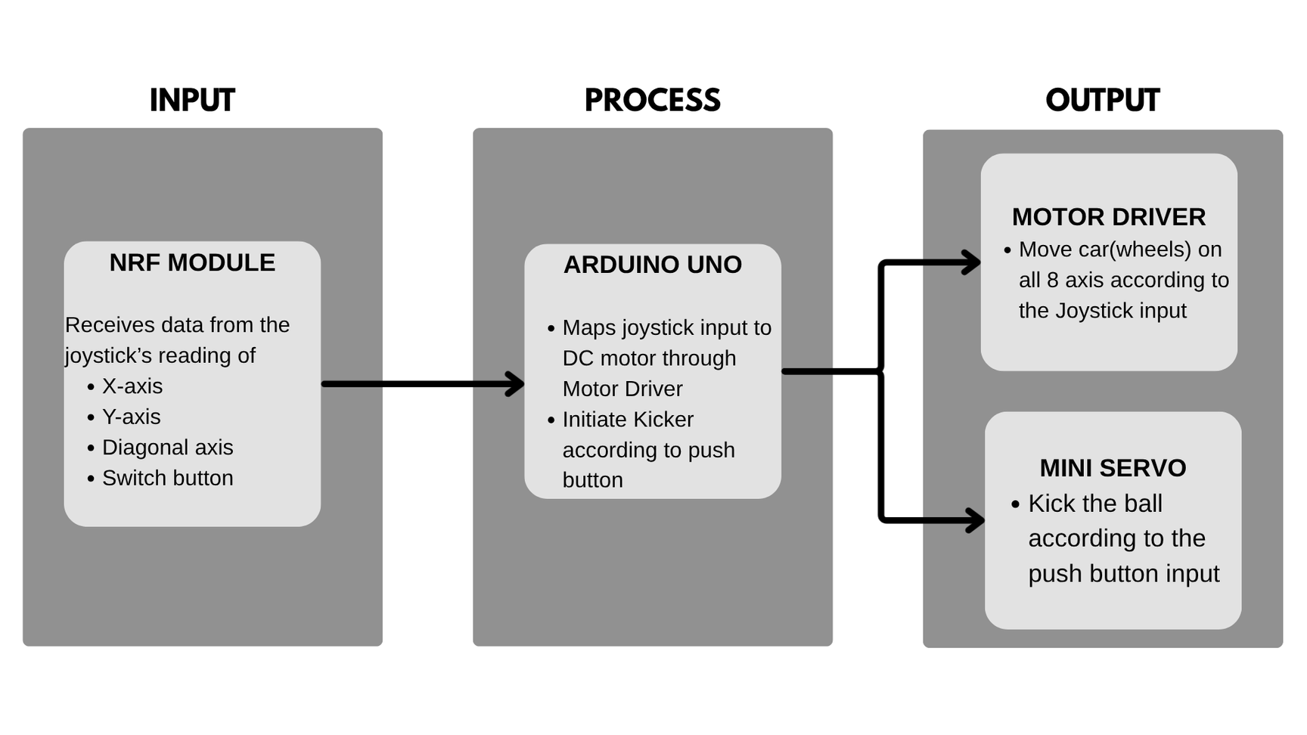
Block diagram
02. CAR

Slide 9
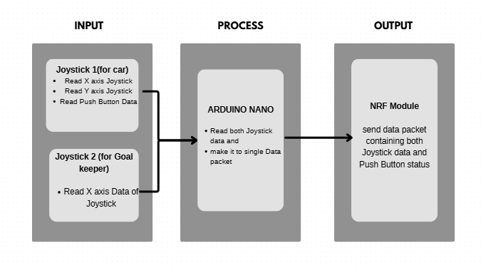
Block diagram
03. CONTROLLER

Slide 10
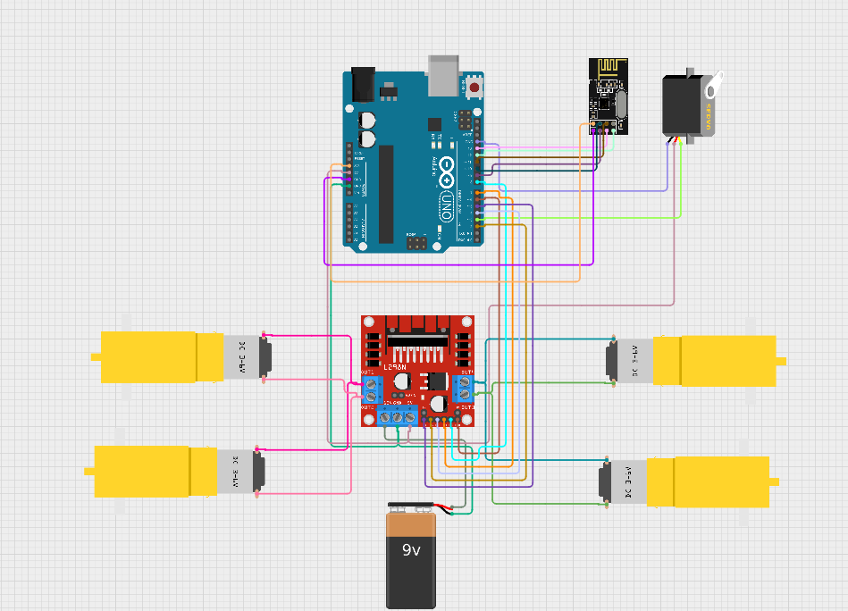
Circuit Diagram
Car

Slide 11
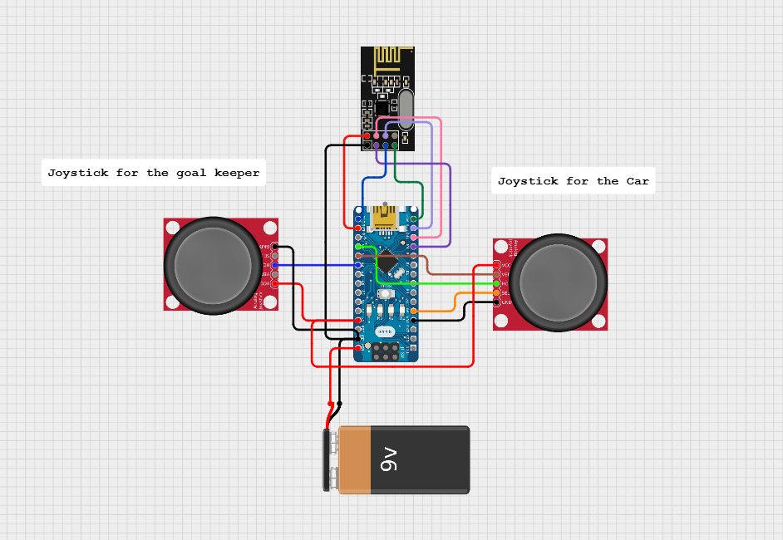
2. Controller

Slide 12
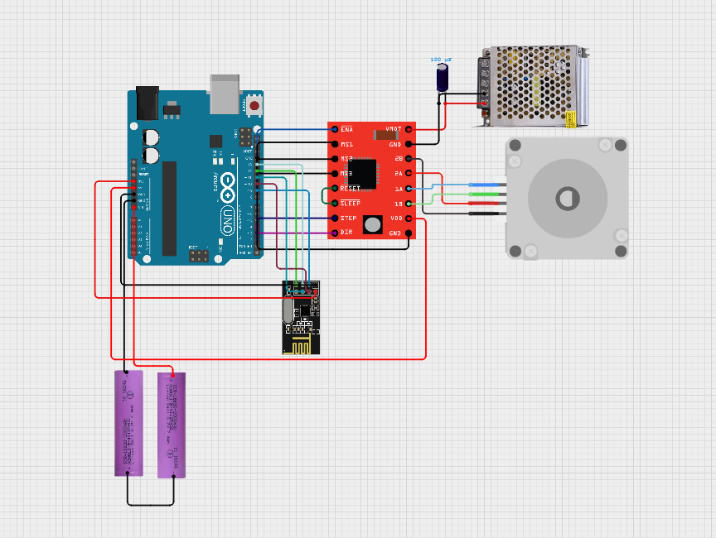
3. Goal Keeper

Slide 13
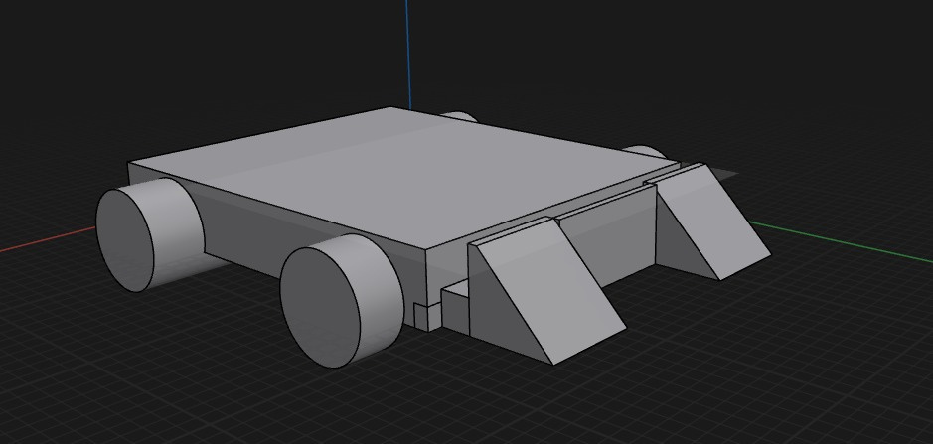

Slide 14
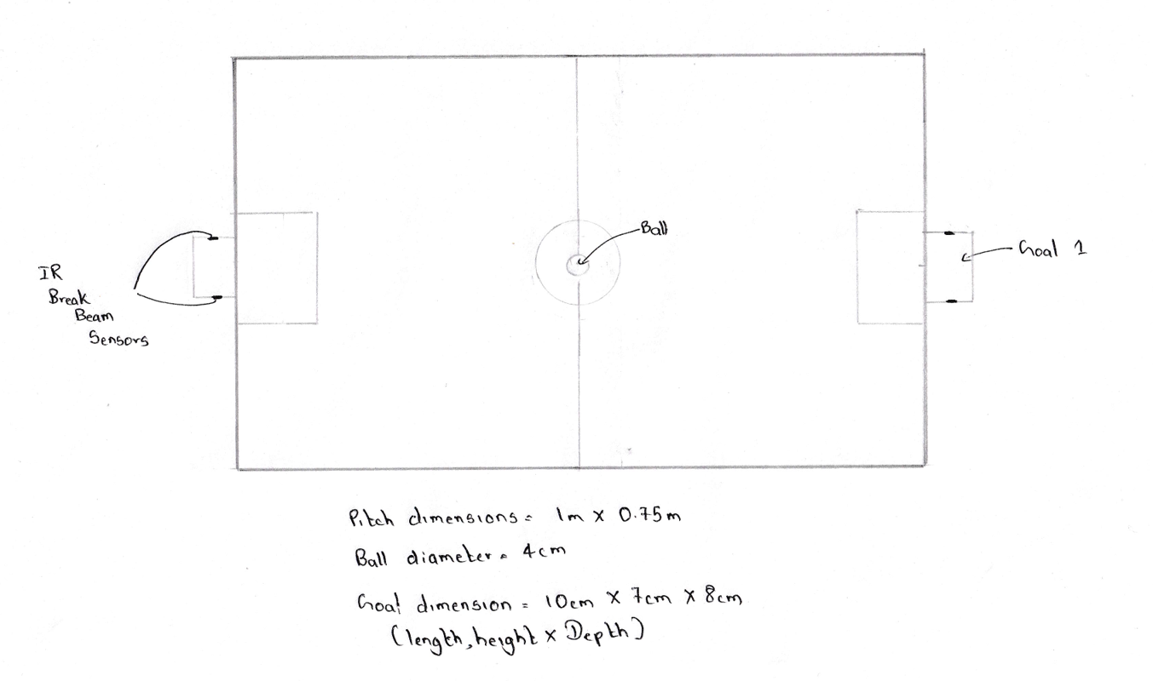

Slide 15
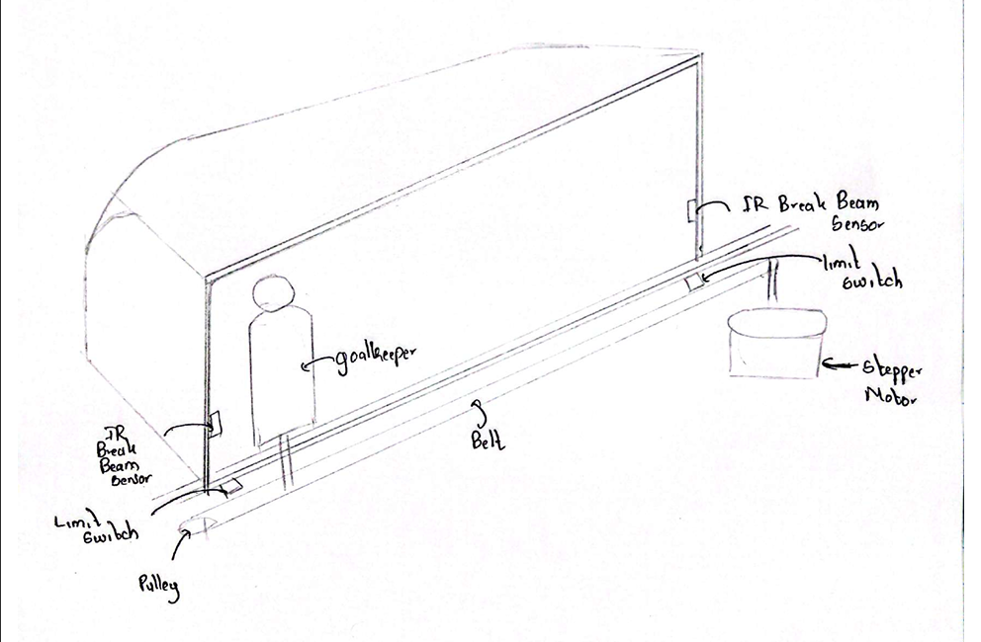

Slide 16
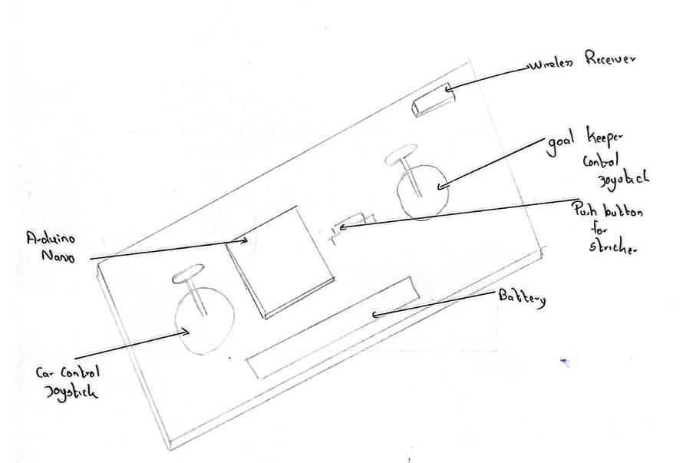

Slide 17
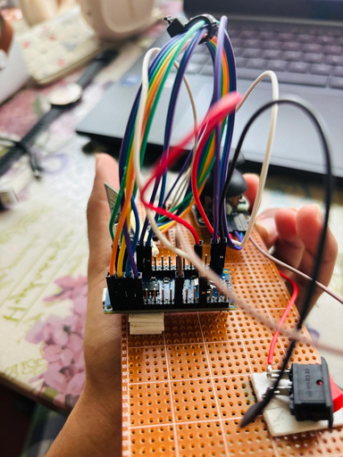
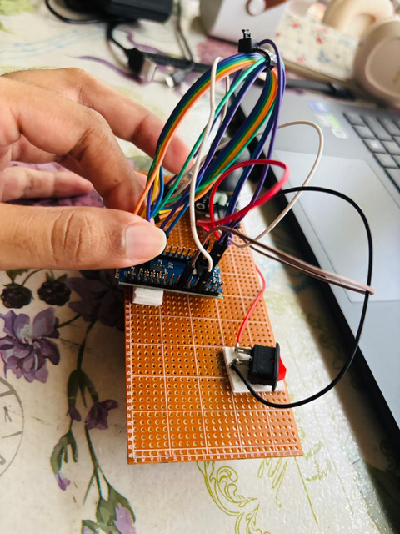
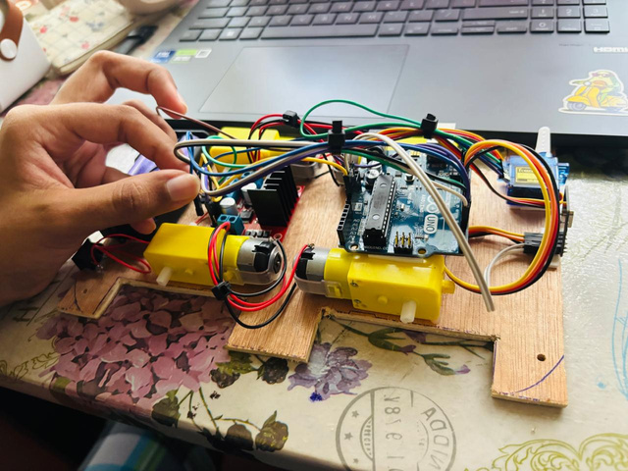
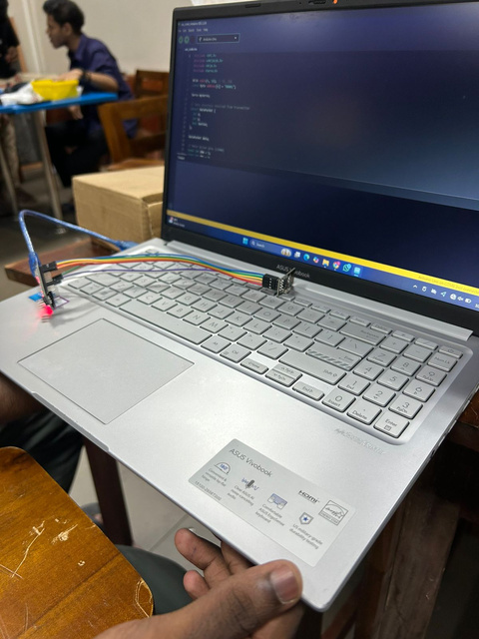
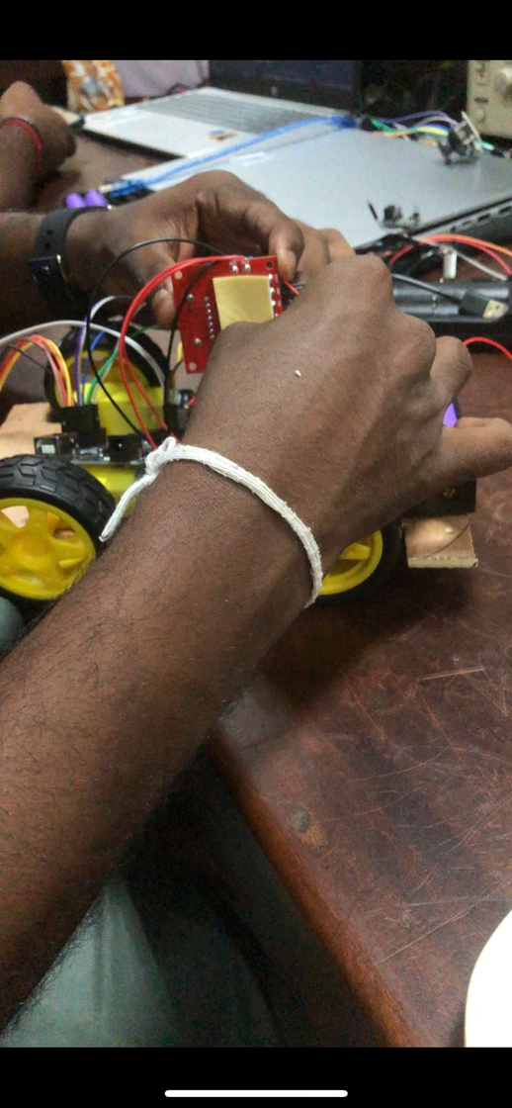
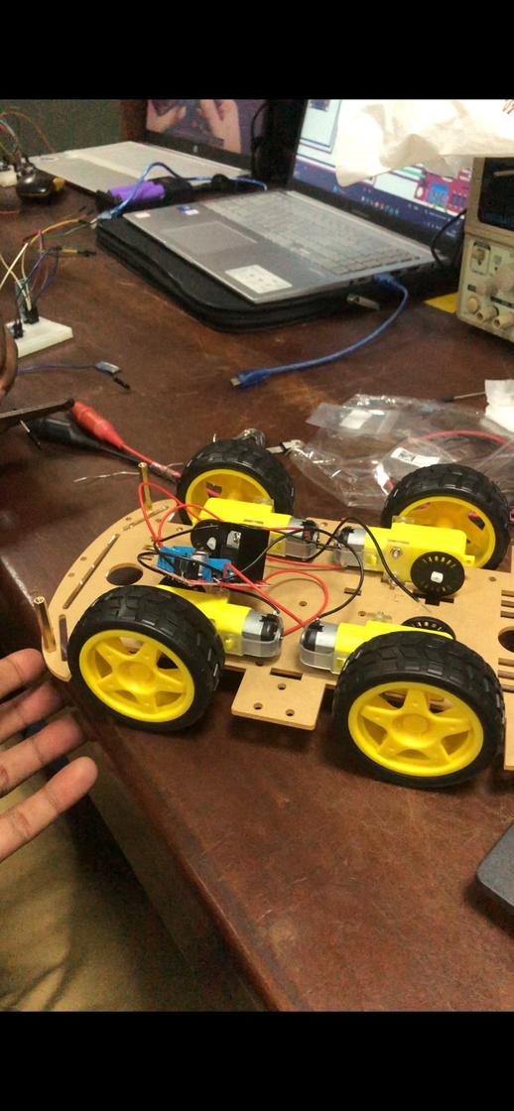
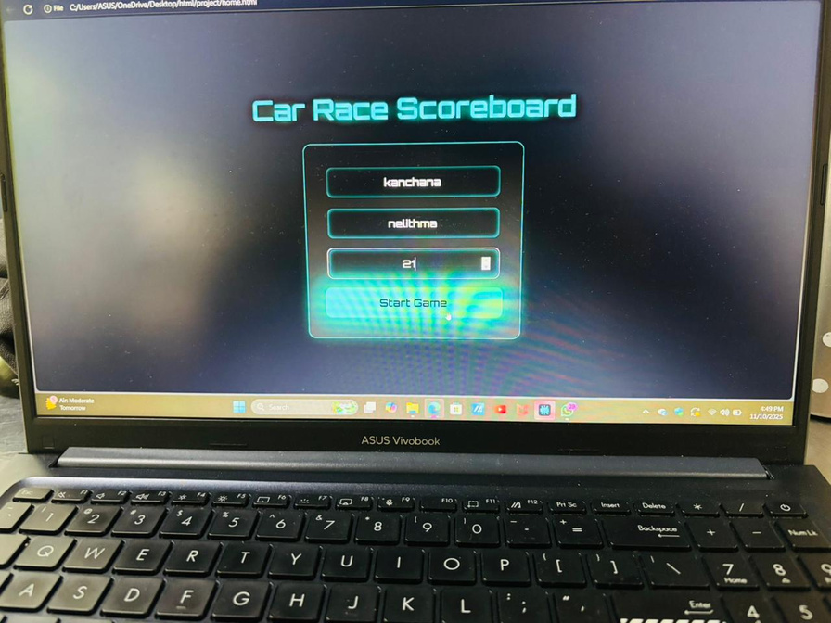
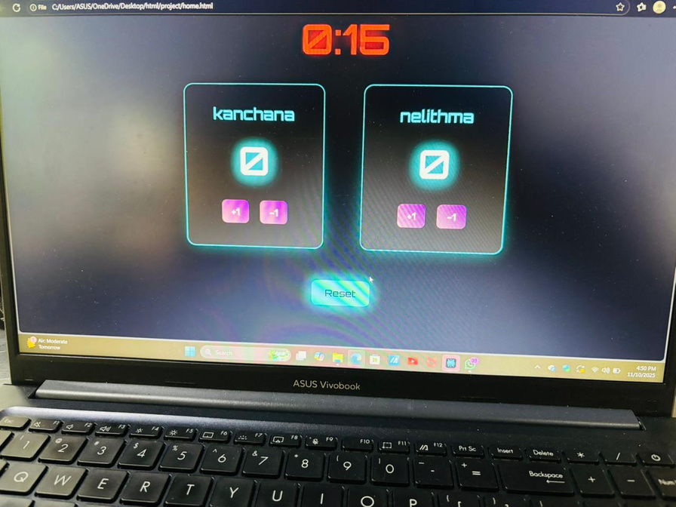

Slide 18
Hardware Components
STRIKER ROBOTS
Arduino Uno
Motor Driver ( L298N)
4× BO gear motors (150–200 RPM)
Mini Servor (Kicker)
nRF24L01 wireless receiver
2× 18650 Li-ion cells (7.4 V total)
Acrylic or 3D printed chassis (~12–15 cm × 10 cm × 7 cm)
JOYSTICK CONTROLLER
Arduino Nano
2× Joysticks (for striker & goalkeeper)
Push button
nRF24L01 wireless transmitter
1× 18650 Li-ion battery
Boost converter (5V output)
AMS1117 voltage regulator (3.3V for nRF module)
ARENA
ESP32 WROOM32
NEMA 17 Stepper Motor
GT2 timing belt or linear slide system (20 cm travel range)
A4988 motor driver
Limit switches (left/right ends)
nRF24L01 wireless receiver
6–9 V DC power supply
(shared)

Slide 19
Software Components
Platform:
HTML, JSON, Python, Arduino IDE, CSS ,JS
Main Functions:
Display real-time score and timer
Detect and register goals via IR break Beam sensor
Handle game start, pause, and reset
Communicate goal confirmation
Display winner at the end of the match

Slide 20
WORK DISTRIBUTION
Team member | Assigned Task
245031B | 1.Assemble chassis 2.Motor functions of car 1 3.Integrate receiver 4.Collaboration with controller 1 for integration 5.Front end UI
245056F | 1.Collaboration with car 1 for integration 2.Collaboration with goalkeeper 3.Game logic and JS function 4.Controller 1 development 5..Web server and ESP32 WebSocket development

Slide 21
Team member | Assigned Task
245060L | 1.Assemble chassis 2.Motor functions of car 2 3.Integrate receiver 4.Collaboration with controller 2 for integration
245057J | 1.Collaboration with car 2 for integration 2.Collaboration with goalkeeper 3.Web server and ESP32 WebSocket development 4.Controller 2 development
245124M | 1.Build 2 rail and goalkeeper mechanism 2.Goal counting with break beam sensors 3.Install limit switches, Speakers. 4.Arena integration

Slide 22
Conclusion
KickBots Arena is an innovative 2-player robotic football system that blends embedded control, robotics, wireless communication, and computer vision into an interactive game experience.
Each player controls a striker robot and its kicker for attacking (drives the ball toward the goal) and a goalkeeper robot for defense (moves along a rail to block goals)
A Web application acts as the main control and display system.

Slide 23
Thank you very much!
PRESENTED BY OHMIES

